Slide 1


VIVEKANANDHA
COLLEGE OF TECHNOLOGY FOR WOMEN
( An University Institution)
Department of Computer Science and Engineering
DETECTION OF BRAIN TUMOR USING DEEP LEARNING AND COMBINATION OF BWT AND KSVM
-------‐----------------------------------------------------
Presented By,
Swetha.G
Pravinicka.S
Guided By,
Mrs.K.P.PORKODI,B.E.,M.E.., AP/CSE

Slide 2
Contents
Abstract
Introduction
Literature survey
Problem statement
Existing system
Proposed System
System requirements
Modules
Modules description
Sample output
conclusion

Slide 3
Abstract
The motivation of this project is to detect the malignant Brain tumor by using EEG signals and K-SVM and BWT Algorithms.
There are many issues and challenges in EEG Signals because of EEG image characteristics like poor image contrast, unknown noise, in homogeneity, weak boundaries and isolated parts can affect the content of the EEG images.
EEG Signals are used to produce electrical waves. EEG activity is quite small and it is measured in microvolts(mV),which is measured from peak to peak and normal range from 0.5-100μV in amplitude, which is about 100 times lower them ECG signals.

Slide 4
CONT….
The analog value is converted into digital value .
From the digital value , we can capture the EEG image of the brain.
The proposed methods ANN with fuzzy rules and K-Means Clustering with ROI and ANN classifier are applied on the EEG image to Detect the Brain tumor among patient.
In the result of this project, we can get the accurate images of high tumor area and the low (or) initial stage of tumors.
.

Slide 5
Introduction
The classification of tumor infected area from EEG signals by the process of the extraction are a major concern and time- consuming task performed by medical specialists by experience only, this accuracy depends consequently. So it is essential to increase the performance and reduce the difficulty includes in the interface method, which has considered Berkeley Wavelet Transformation (BWT) based segmentation with k-means clustering. The proposed method first employs wavelet transform to extract features from signals is followed by applying Principle Component Analysis (PCA) to reduce the dimensions of features. The reduced features were submitted to a Kernel Support Vector Machine (KSVM).

Slide 6
Literature survey
(S. Harish, G. F. A. Ahammed and R. Banu.,2017)_ An extensive research survey on brain MRI enhancement, segmentation and classification.
(P. Bizopoulos, G. I. Lambrou and D. Koutsouris.,2019)_ Signal Image Modules in Deep Neural Networks for EEG Classification.
(M. Papezova and D. Faktorova.,2015)_ Automatic localization of epileptic seizures as a symptom of brain tumor.
(G. Wang, L. Yang, G. Worrell and B. He.,2009) _The relationship between conductivity uncertainties and EEG source localization accuracy.
(C. Kao.,2013)_ E-Health Design of EEG Signal Classification for Epilepsy Diagnosis.

Slide 7
Problem statement
The cause of brain tumor formation is the abnormal mass or growth of cells in the human brain. The skull around the brain of the man is very strong space can lead to more problems.
Any unnecessary growth within a very strong space can lead to more problems.
In addition, some tumors in brain tumors may be cancerous and non-cancerous. Brain tumor with cancerous are called malignant, and non-cancerous are called benign.
As these two tumors grow, they can put pressure on the inside of the skull. Thus, the brain becomes vulnerable and endangers human life.

Slide 8
Existing System
The adaptive spectral filter is presented to enhance the standard of the image quality to create it prepared for additional process by eliminating the not related and extra elements within the background of the EEG.
K-means clustering with Probabilistic neural networks can be presented to improve Signal quality and to provide accurate results.
Co-occurrence Matrix can be employed to extract the features from the texture in signal that features may be in the form of structure, location and outside etc.

Slide 9
Proposed System
When compared with the manual detection performed by radiologists or clinical experts, the experimental results performed on the different images it is clear that the study of the brain tumor detection is fast and accurate.
Moreover to increase the accuracy and quality rate, this approach extracts the statistical features using Berkeley Wavelet Transform and the result is then given to Kernel Support Vector Machine for tumor classification as Benign or Malignant.
The proposed approach shows in the experimental results it can aid in accurate and detection of the brain tumor in exact location at time.

Slide 10
SYSTEM REQUIREMENTS
HARDWARE REQUIREMENTS
System : Pentium IV 2.4Hz.
Hard Disk : 500 GB.
Monitor : 15 VGA Colour.
Mouse : Logitech.
RAM : 4GB.

Slide 11
CONT…
SOFTWARE REQUIREMENTS
Operating system : Windows
Coding Language : PYTHON 3.5
IDE : Anaconda Navigator
Datasets : EEG Dataset

Slide 12
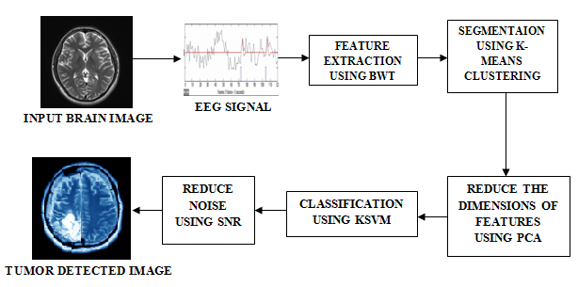
Data Flow Diagram

Slide 13
Modules
Deep Learning
EEG Signal
CAD (Computer-Aided Design)
Wavelet Transform
BWT (Berkeley Wavelet Transformation)
K-Means Clustering

Slide 14
Module Description
DEEP LEARNING
Deep learning is the role of machine learning. It is based on artificial neural networks. This is because the neural network can replicate the functions of the human brain. In deep learning, there is no need to program all the information explicitly.

Slide 15
CONT…
EEG SIGNAL
EEG stands for Electro Encephalo Gram. It is a signal test. It is used to evaluate the electrical activity in the brain. Cells in the brain interact with each other through electrical impulses. The EEG signal is used to detect a related problem in this process. The EEG signal pathways and records the wave patterns in the brain.

Slide 16
CONT…
CAD (Computer-Aided Design)
A CAD (Computer-Aided Design) is the use of computer software to document and design a product design. This CAD technique enables automated conversion of information about an object into more detailed information. And it is also used to create a normal map into two-dimensional and three-dimensional images.

Slide 17
CONT…
WAVELET TRANSFORM
When the frequencies of signals vary, a mathematical calculation for analysis the signals is called wavelet transformation. Wavelet analysis provides more accurate information about signals and images, compared to other signal analysis techniques.

Slide 18
CONT…
BWT (Berkeley Wavelet Transformation)
Berkeley Wavelet Transformation uses a two-dimensional triangular bandwidth. And in terms of complete orthogonal, this is the best method to identify the affected tumor area from the brain image. So in this paper, we used the Berkeley Wavelet Transformation method for brain tumor division. It is used to analyze or process image or signals. And this BWT is used in tuning of bandpass orientation, quadrature phase, frequency bandpass, and spatial localization.

Slide 19
CONT…
K-Means Clustering
Clustering is the most common data analysis technique. It is used to obtain insight into the structure of image data together, it segregates each type separately. K-Means clustering excels in this clustering method, which is very important and accurate. Therefore, for image segmentation in this paper, we used BWT with the help of the K-Means Clustering method.

Slide 20
Sample code
import tensorflow as tf
from numpy import random
import tqdm
%matplotlib inline
import csv
import numpy as np
from scipy.stats import expon
import pandas as pd
import matplotlib.pyplot as plt
import seaborn as sns
sns.set(font_scale=1.2)
data1 = np.loadtxt('C:/Users/ImmaTech/Downloads/Heart_ECG/bit1.csv')

Slide 21
CONT…
data2 = np.loadtxt('C:/Users/ImmaTech/Downloads/Heart_ECG/bit2.csv')
a = data1.tolist()
p = data2.tolist()
print(a)
btod1 = []
btod2 = []
fbtod = []
for x in range(3000):
b = str(a[x]).strip('[]')
c = b.split('.')
d = int(c[0],2)
btod1.append(d)

Slide 22
CONT…
for y in range(3000):
q = str(p[y]).strip('[]')
r = q.split('.')
s = int(r[0],2)
btod2.append(s)
for z in range(3000):
fbtod.append(str(btod1[z])+"."+str(btod2[z]))
write_data = open('C:/Users/ImmaTech/Downloads/Heart_ECG/Dataset/Final.csv','w')
out = csv.writer(write_data)
out.writerows(map(lambda x:[x],fbtod))
write_data.close()

Slide 23
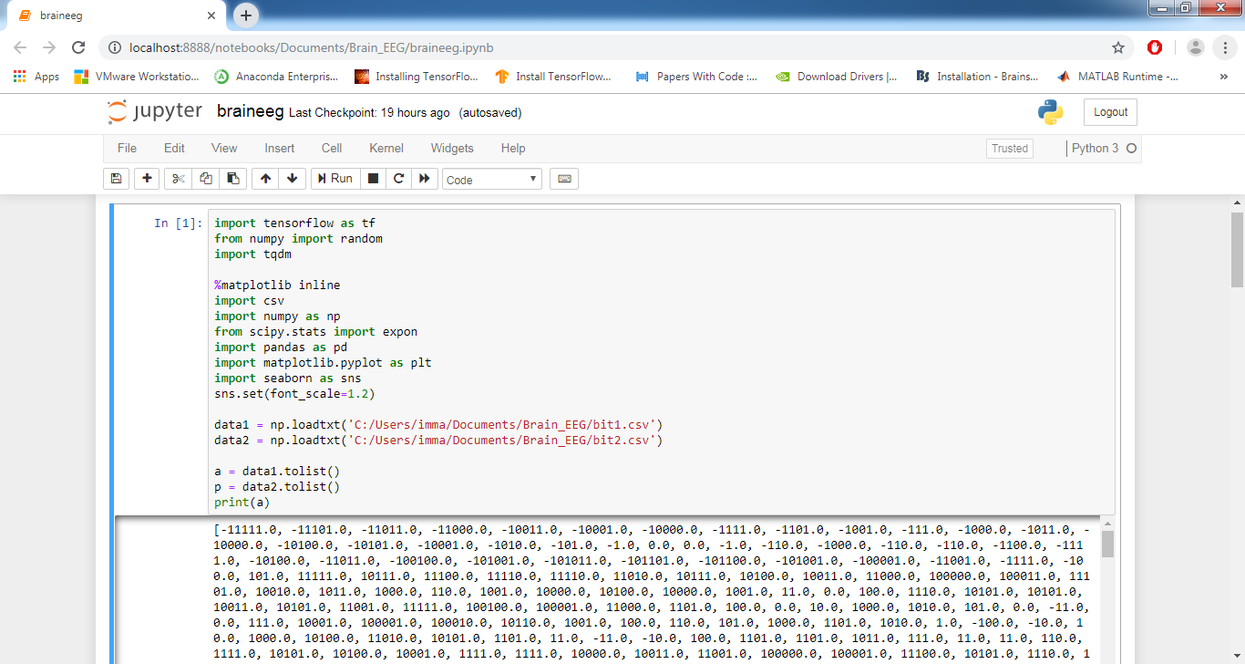
Sample output

Slide 24
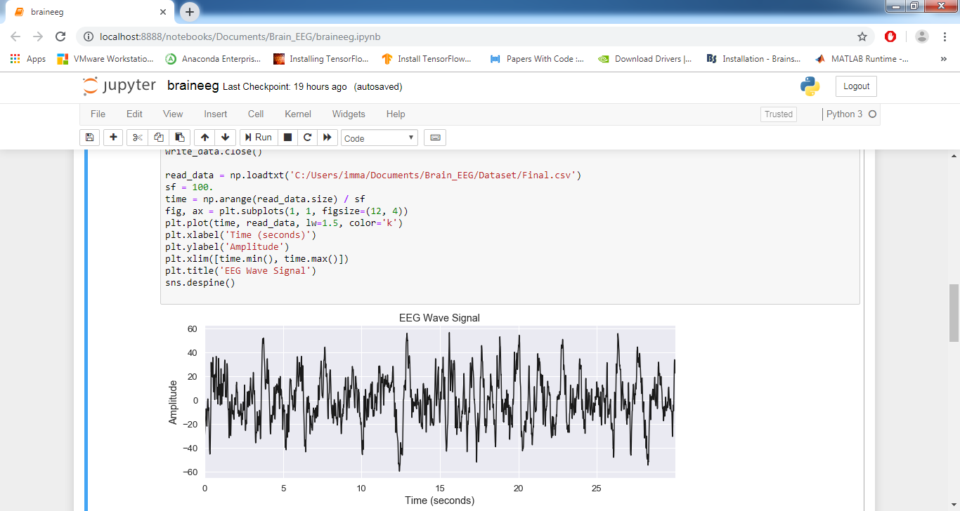
CONT…

Slide 25
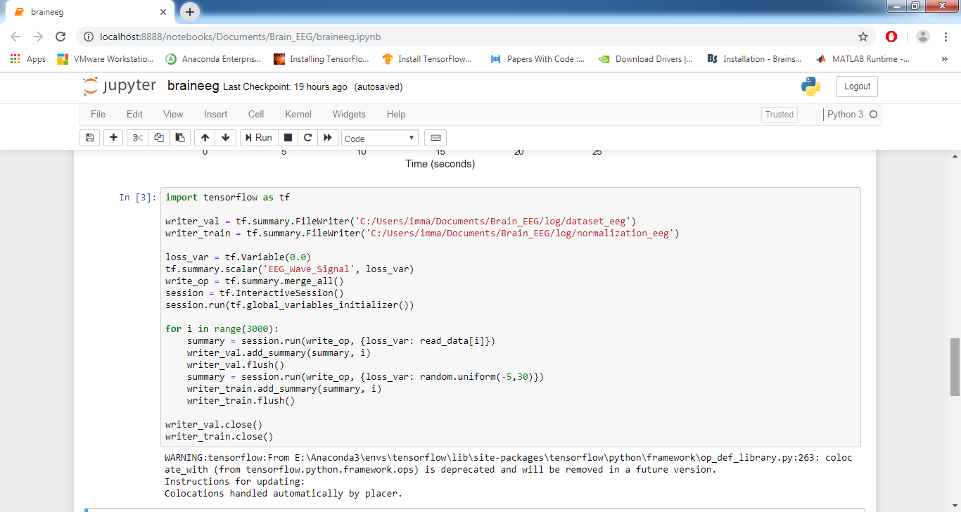
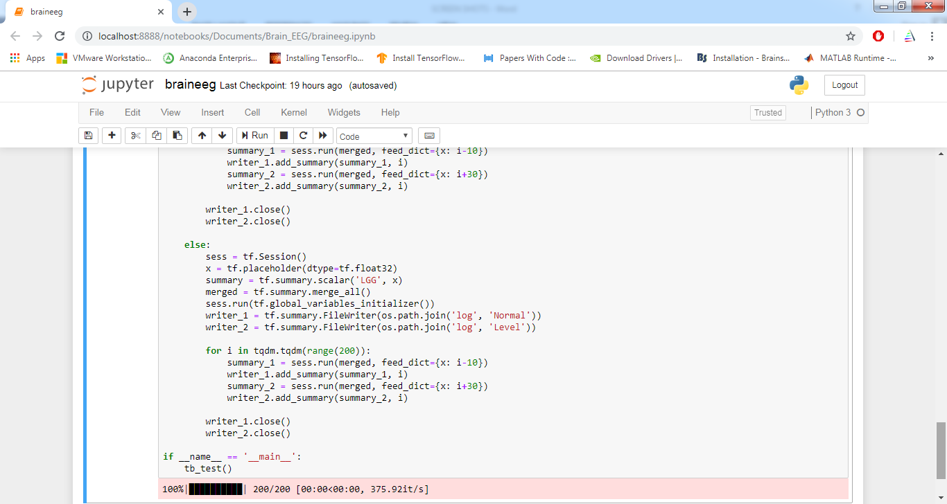
CONT…

Slide 26
CONT…

Slide 27
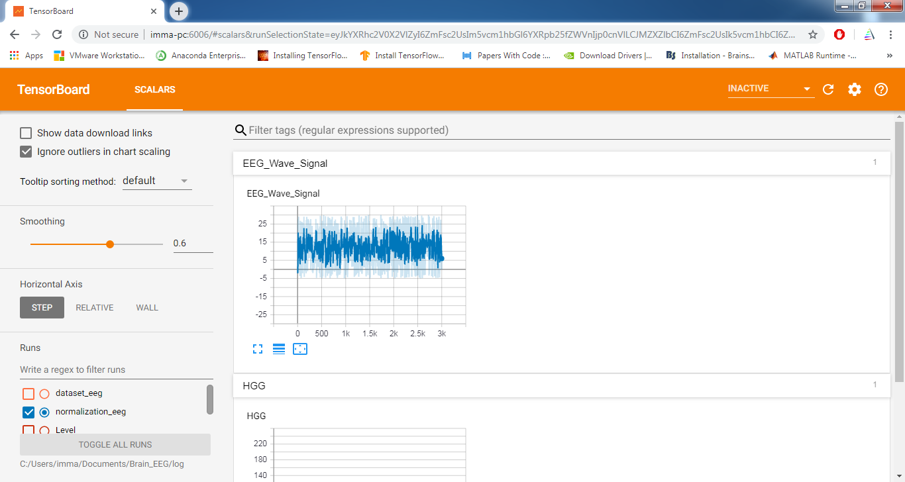
CONT…

Slide 28
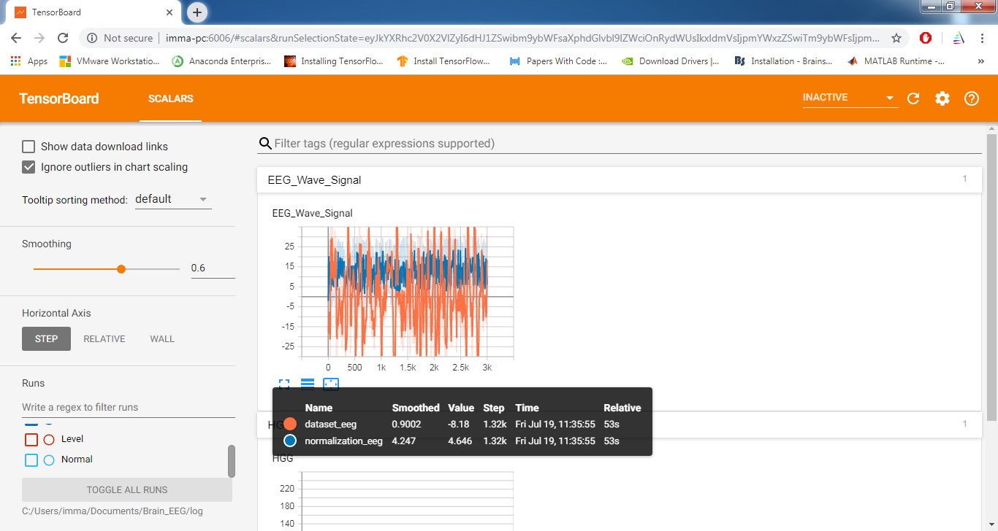
CONT…

Slide 29
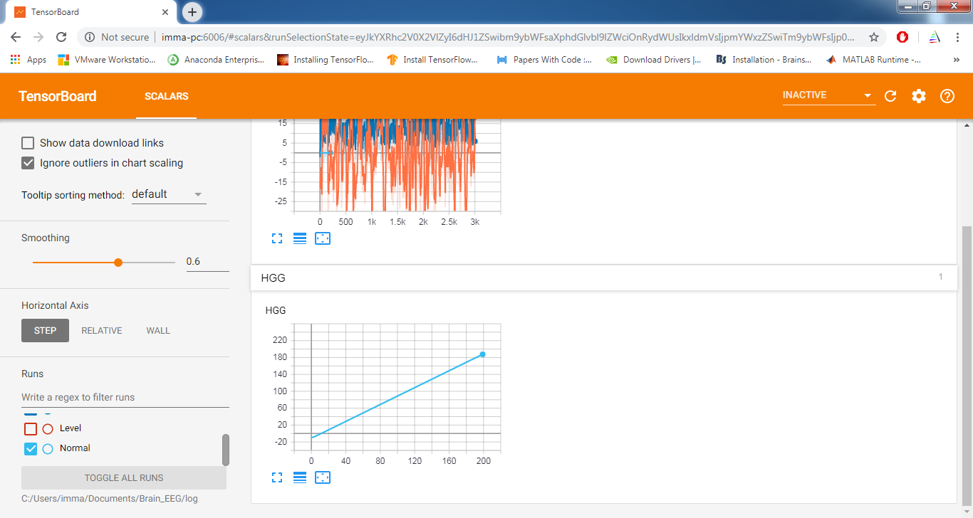
CONT…

Slide 30
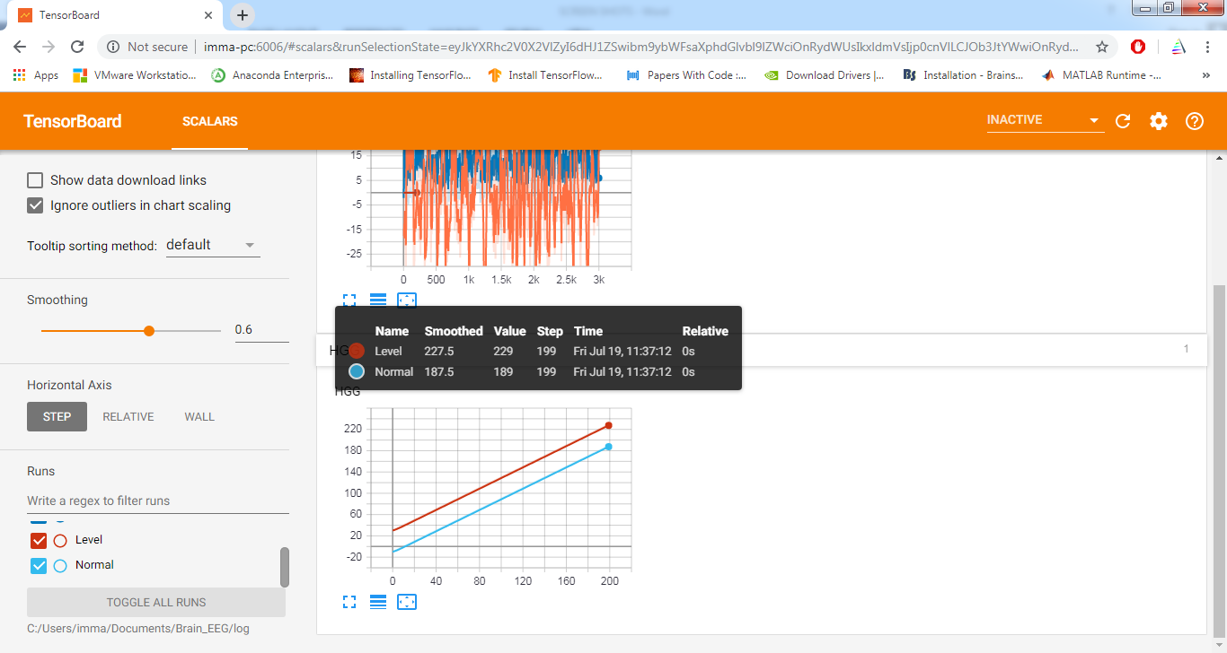
CONT…

Slide 31
Conclusion
Using EEG signals furthermore, BWT is used to classify the tumor stage by analyzing vectors and area of tumor to segment the images and SVM. The Signal to Noise Ratio(SNR)is improved to eliminate the effect of unwanted noise and combined technique is used to detect and classify tumor from brain signals. When compared with the different images it is clear that the study of the brain tumor detection is fast and accurate. The proposed approach shows in the experimental results it can aid in accurate and detection of the brain tumor in exact location at time.

Slide 32


